Slide 2
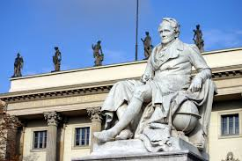
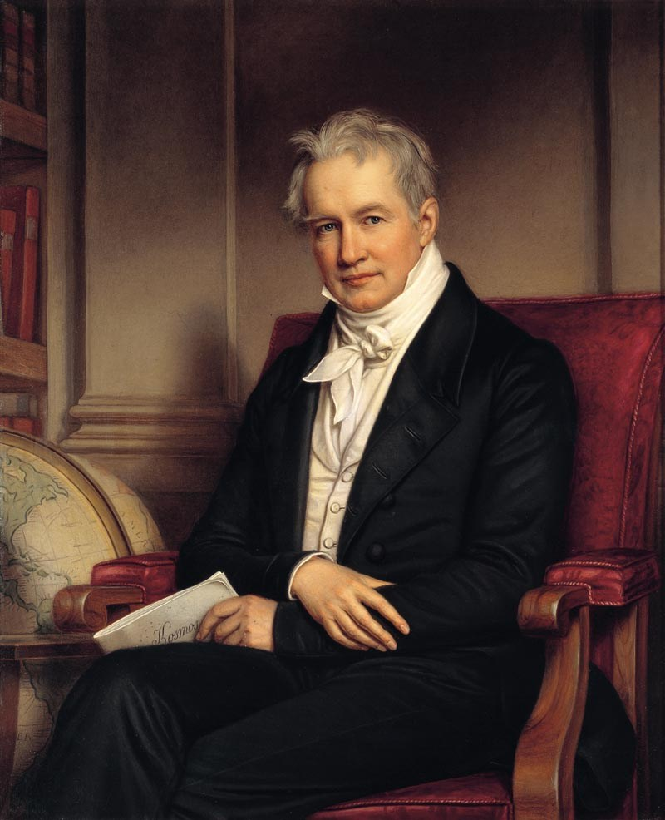
Die Menschen haben die Macht die Umwelt zu zerstören und die Folgen könnten katastrophal sein.
Alexander von Humboldt, 1800

Slide 3
Energiewende Electrons or chemical bonds?

Slide 4
EU energy consumption
Source:
Eurostat (2016)
Top 4 countries account for 56% of energy budget.
Strong overall reduction targeted.
Mild reduction due to globalization, less due to efficiency.

Slide 5
German power structure
Source:
AGEB after
BMWI (2016)

Slide 6
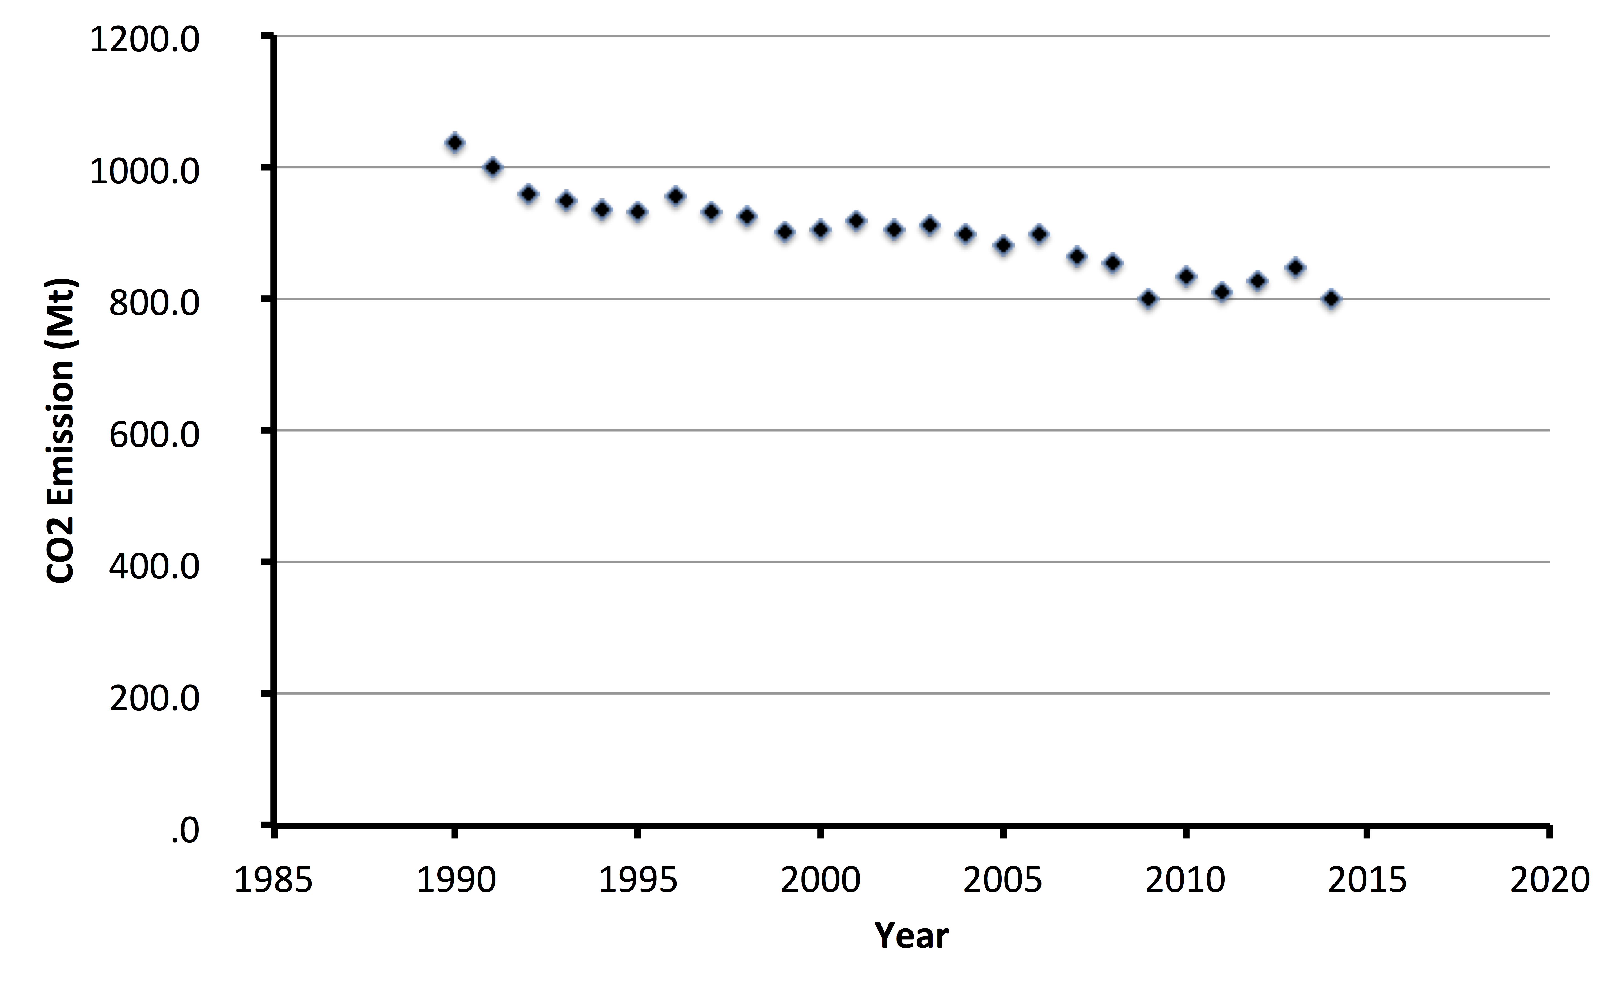
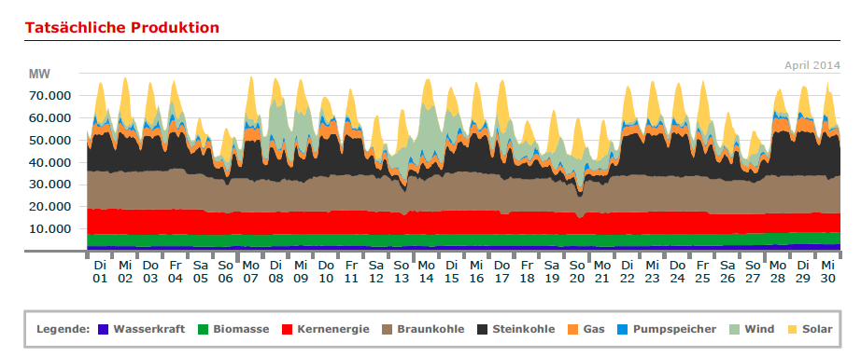
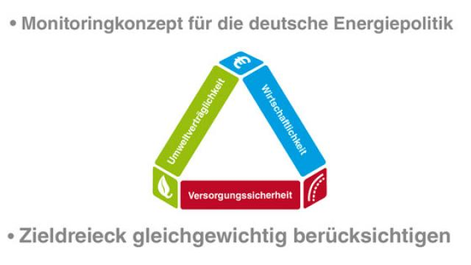
The results
Source.UBA (2016)

Slide 7
Too many expectations?
Source:
AGEB after
BMWI (2016)

Slide 8
Consequences I
We have much REN power capacity.
We cannot effectively use it.
We consume a vast majority still in fossil resources.
We need to cater for volatility technologically, economically and in the society.
Without caring for the systemic nature of energy transformation no breakthrough.

Slide 9
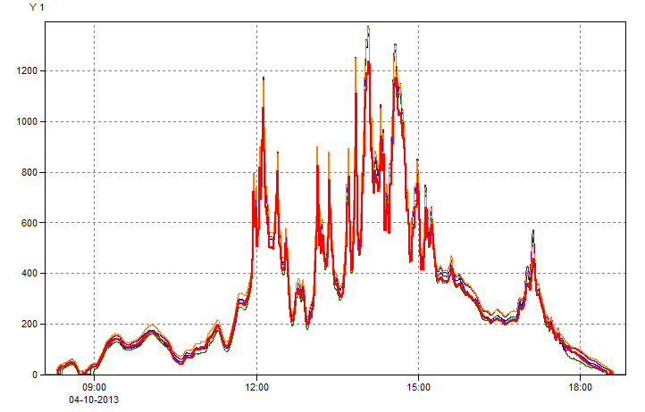
Volatility
REN is always volatile.
High REN fractions in sustainably systems require massive overpowering: utilization essential for economic success.
Remaining uncovered times require combustion/nuclear systems of today´s capacity.
Require co-generation of economically useful products.
Most useful sector integration is transportation fuel.
Green heat for domestic application including storage is economical addition for top 500 h of overpower.
Source: ESYS, 2015

Slide 10
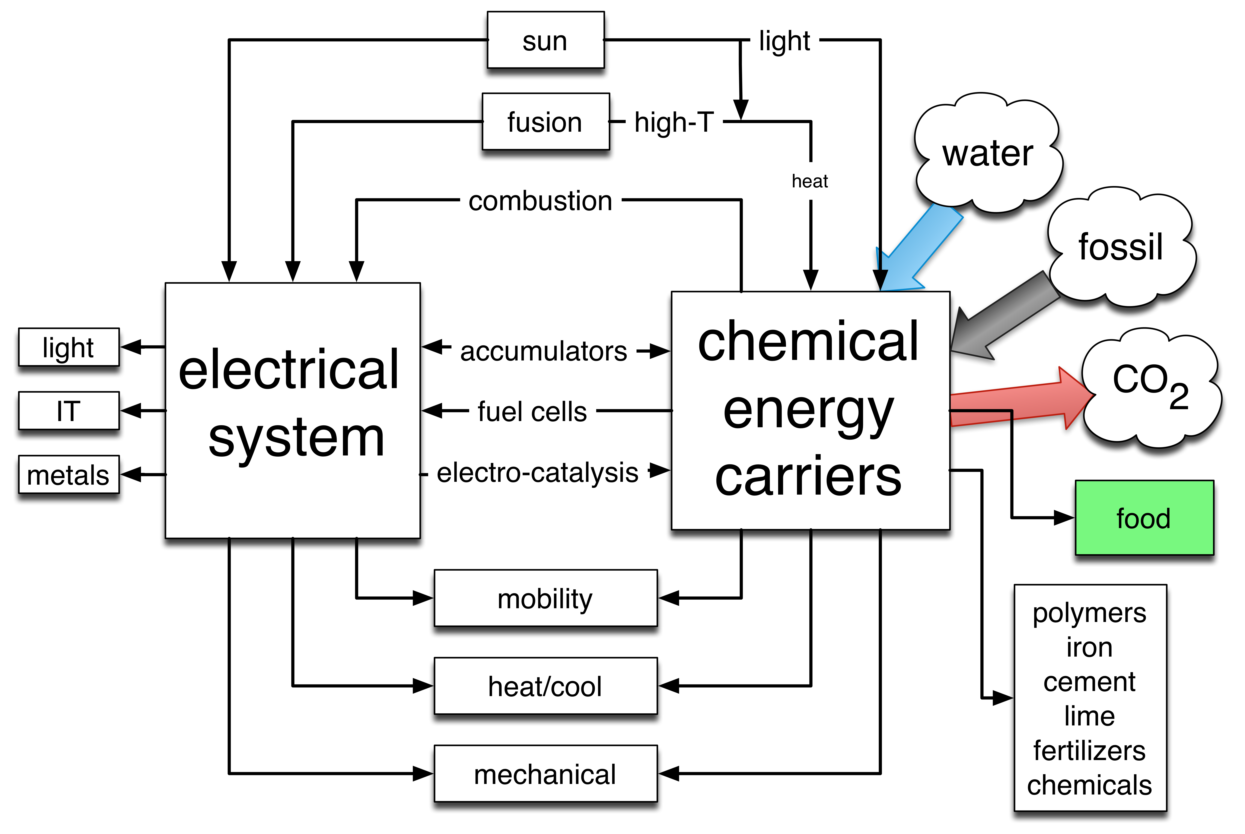
Decarbonisation
The quest for sustainable energy leads to a pressure against using fossil (and nuclear) fuels.
Wind and solar electricity offer this potential for part of the electricity system.
Volatility and inescapable uses of chemical energy carriers require the conversion of electricity into chemistry: solar fuels.
The use of CO₂ as feedstock rather than as waste is demonstrated in nature on a much larger scale than we need.
The technological realization of such processes is still missing.
Avoiding much emission from fossil sources remains a critical goal for sustainable energy systems.

Slide 11
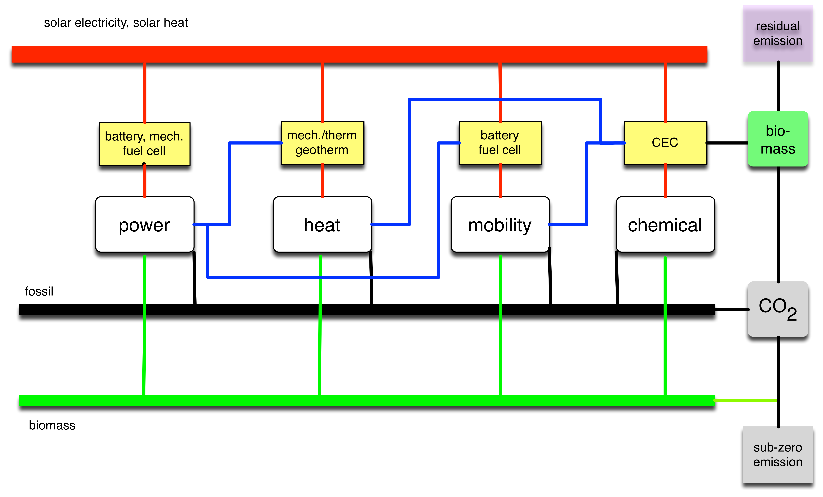
Strategies for unaccounted CO₂ minimization: note dimensions
Not CO₂ itself but unaccounted CO₂ is the problem.
Reduction of fossil sources is essential, immediate removal is unwise.
Energy saving is critical but must be done in systemic socio-economical manner.
It is critical to begin with intentional reduction of CO₂ emission (not existent today!).
The master plan is a combination of fossil minimization with a recycling concept.
Close the man-made CO₂ cycle as nature does
Not de-carbonisation but de-fossilization

Slide 12
Chemical Industry
Conservative by-stander in past energy transformations:
New business opportunities, adaptation for own feedstock supply.
De-fossilization will profoundly change this picture.
Traditional businesses will disappear rapidly on the time scale of the industry.
Core technology „catalysis“ will remain.
Challenges for novel reactions and process designs.
Much larger scale of application.
Are we ready for these challenges??
Do we see this vision or will we remain passive?

Slide 13
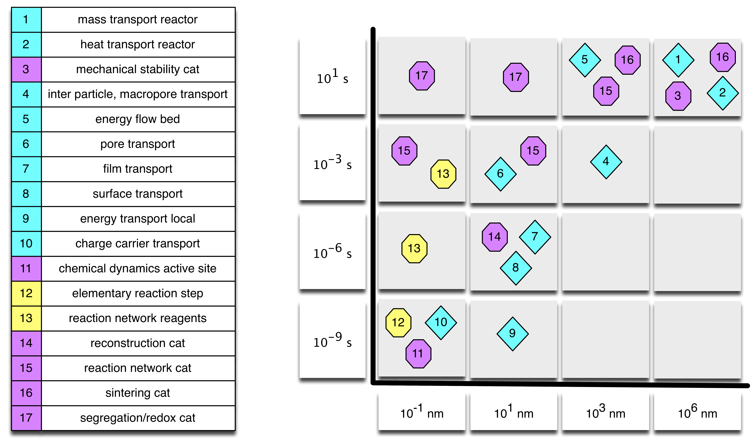
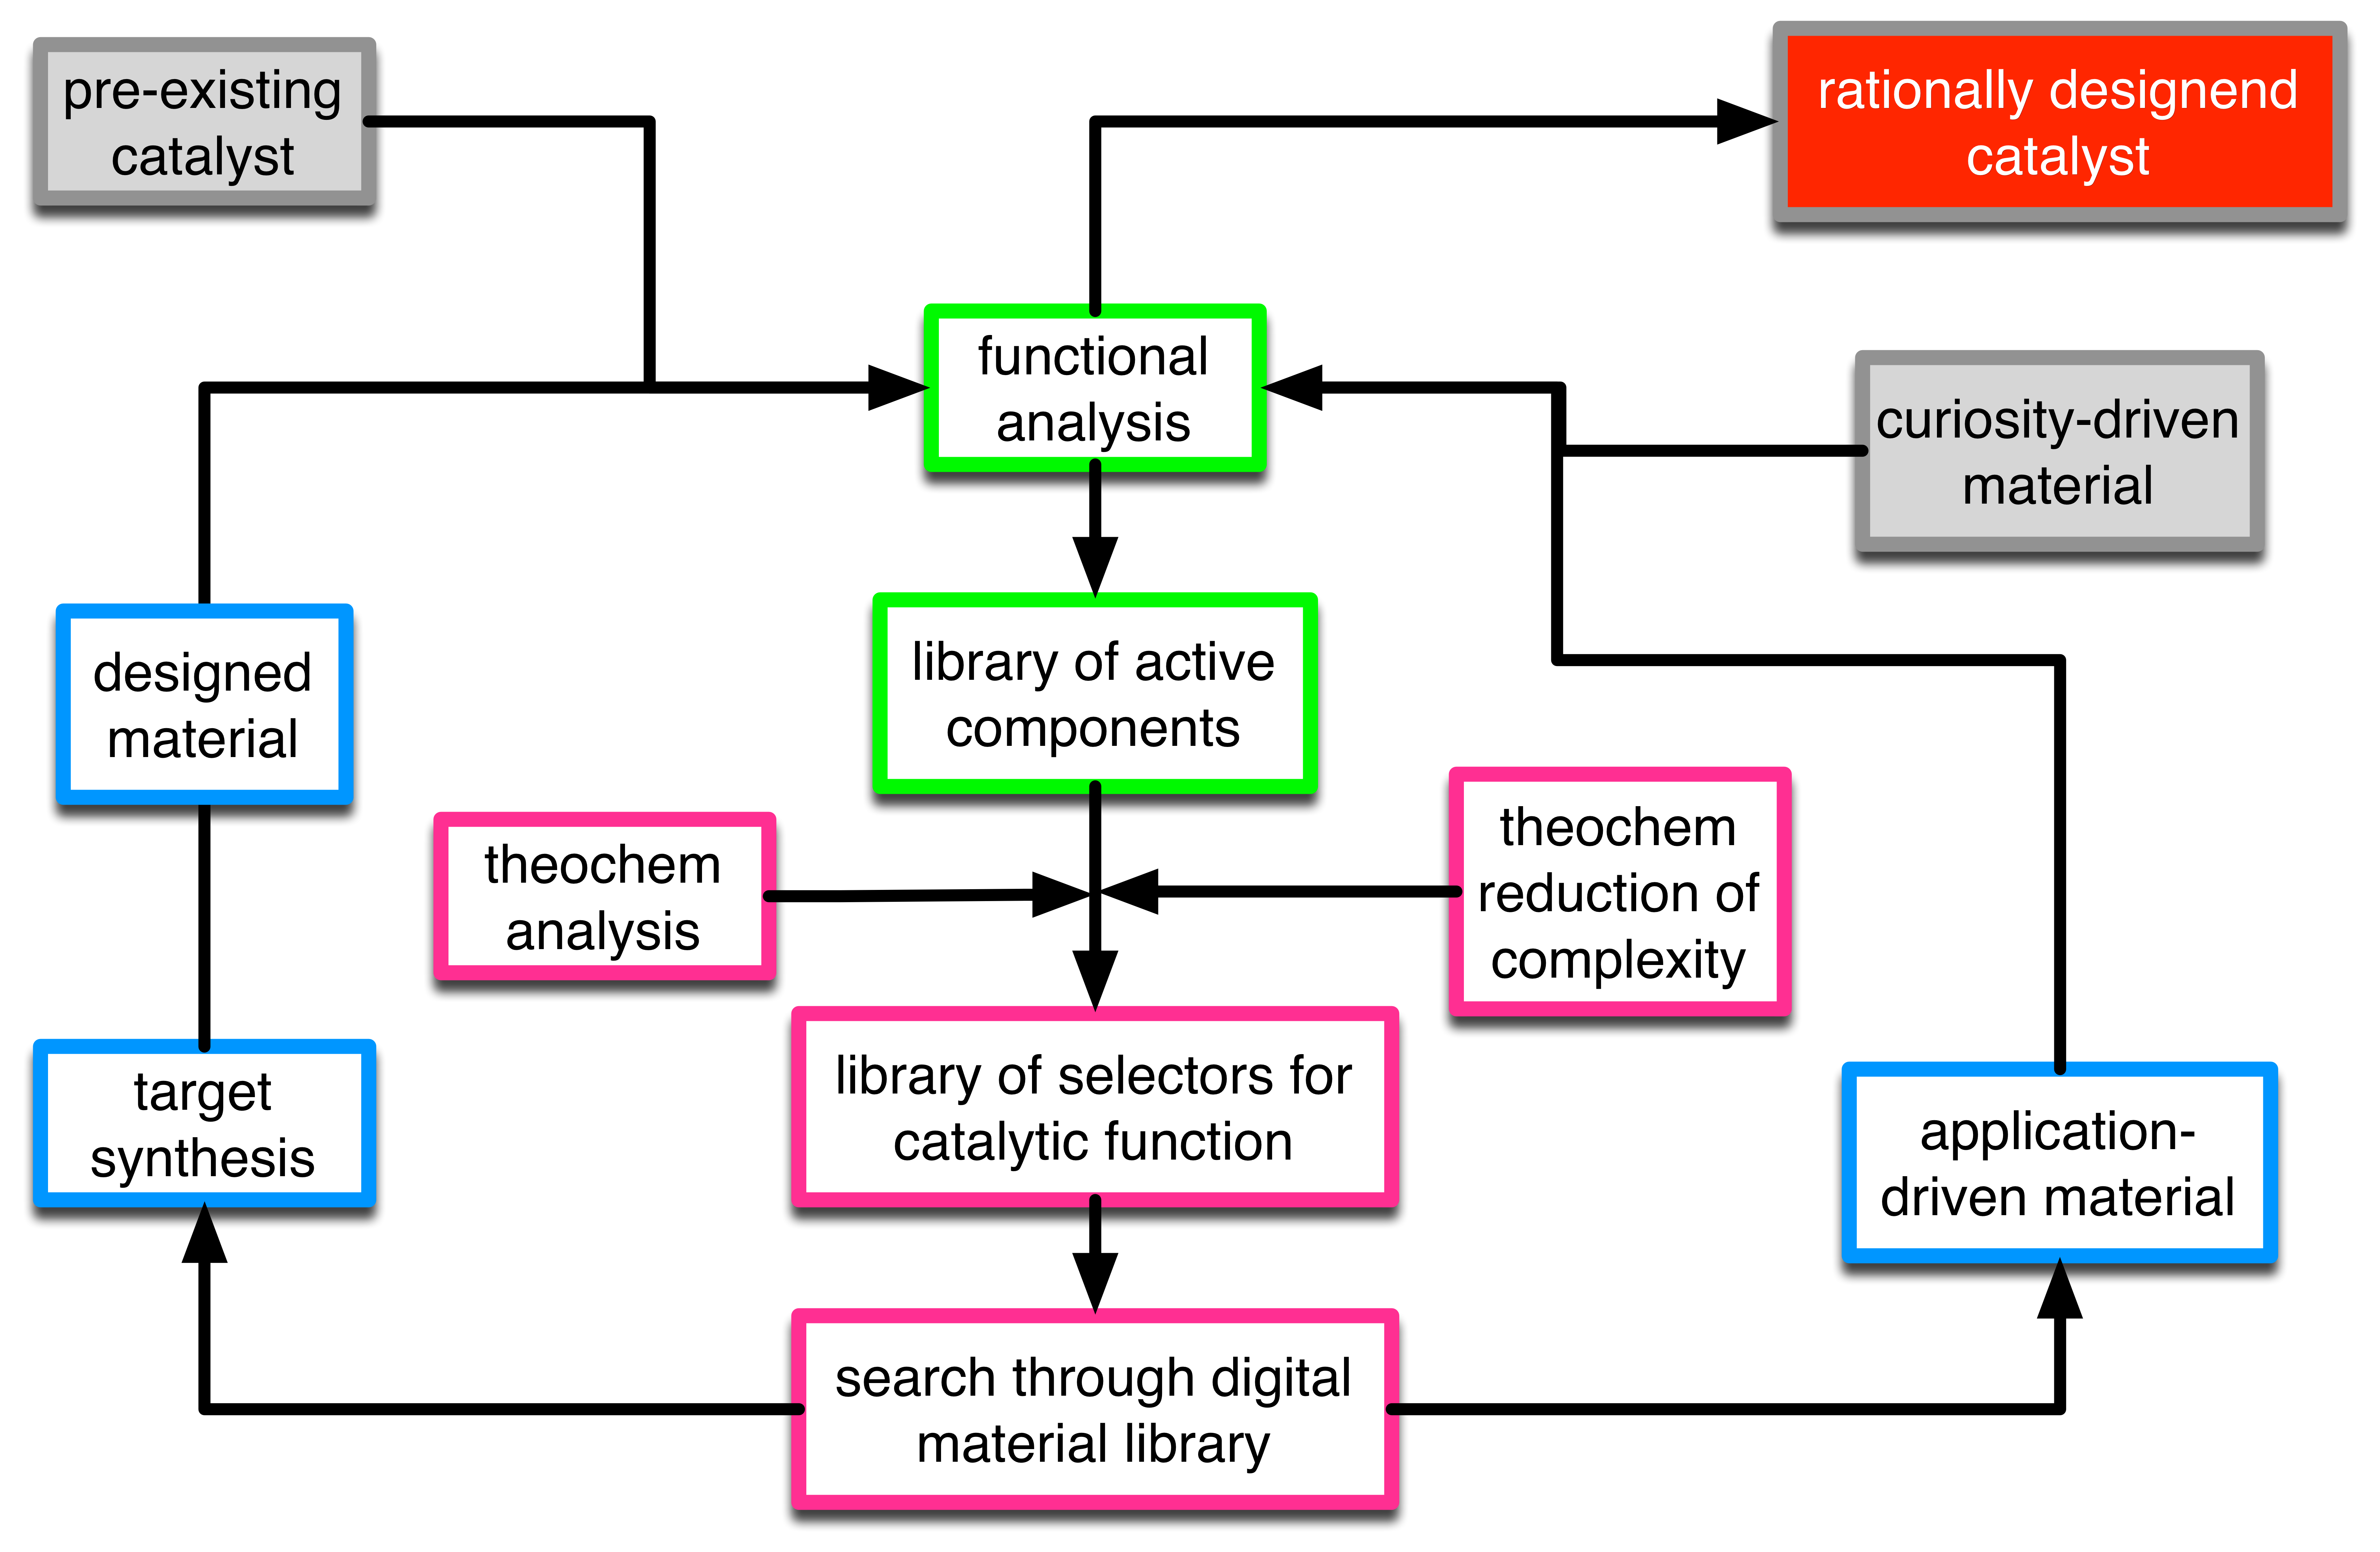
Catalysis today
Heterogeneous catalysis science has made a breakthrough development.
We understand the complexity of a multi-dimensional phenomenon.
We cope with reaction networks rather than their formal simplifications.
We accept chemical dynamics as rule rather than curiosity.
We have a theory-supported integrated workflow supporting traditional chemical engineering with practical realizations.
Can only be executed in collaboration (see the microelectronics challenge).

Slide 14
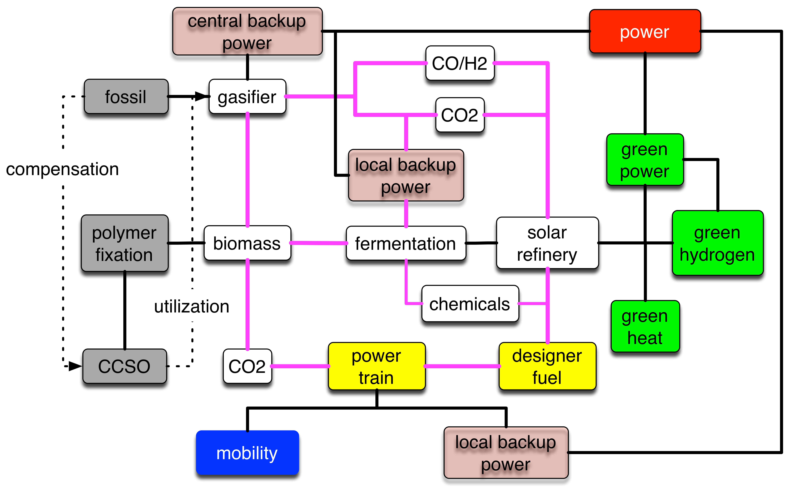
Transformation path
A non fossil energy system will come gradually.
Time scales 20 years plus (investments, societal readiness, business models).
Exceptions where geo/political conditions allow.
The technical carbon cycle will be closed most economically through cross-industrial integration with mobility and with the backup power generation.
Biomass as collector for carbon not as energy source.
Conversion of volatile green electricity through water splitting into hydrogen.
Heat demads are cross-sectional to this process

Slide 15
Consequences II
The systemic solution is a closed carbon cycle with a decreasing use of fossil resources.
Biomass gains the role of the carbon collector rather than energy collector.
Critical is green hydrogen.
This requires green power (accountable!).
In combination with backup energy
Science and technology:
Solve basics of water splitting by electro catalysis (stability, material, design)
Find multiple technological solutions (aqueous, HT, scalable).
Think about different scales (distributed, vs central).
Regulatory (boundary conditions for S+T):
Remove subsidies.
Create a technology-open frame for energy transformation with long time stability (e.g. a modified ETS).
Command their fulfilment.

Slide 16
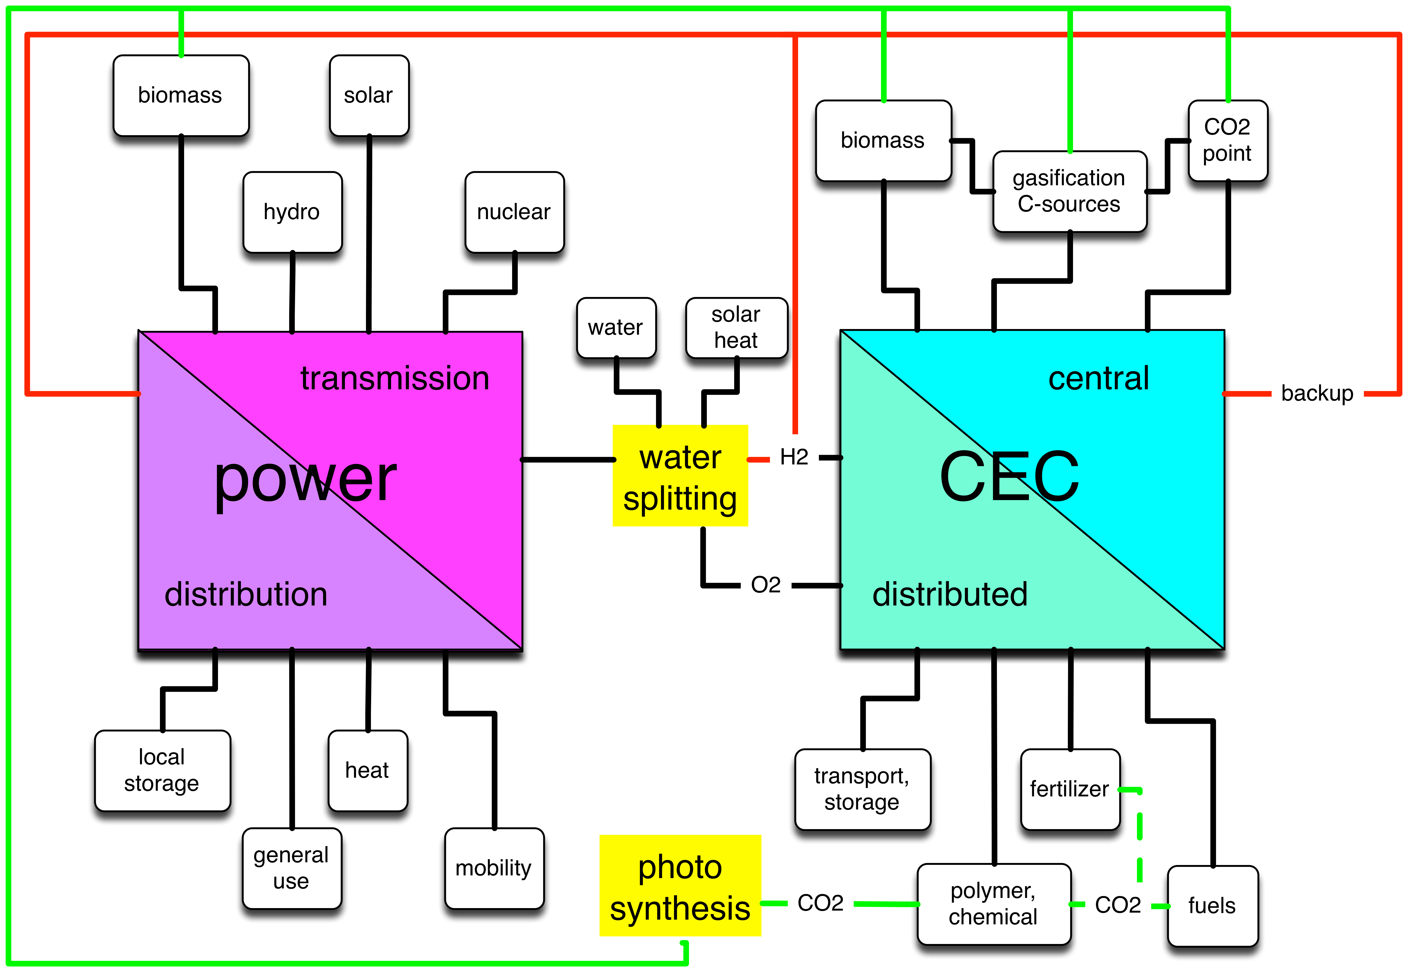
(Masterplan) What we need in multiple options

Slide 17
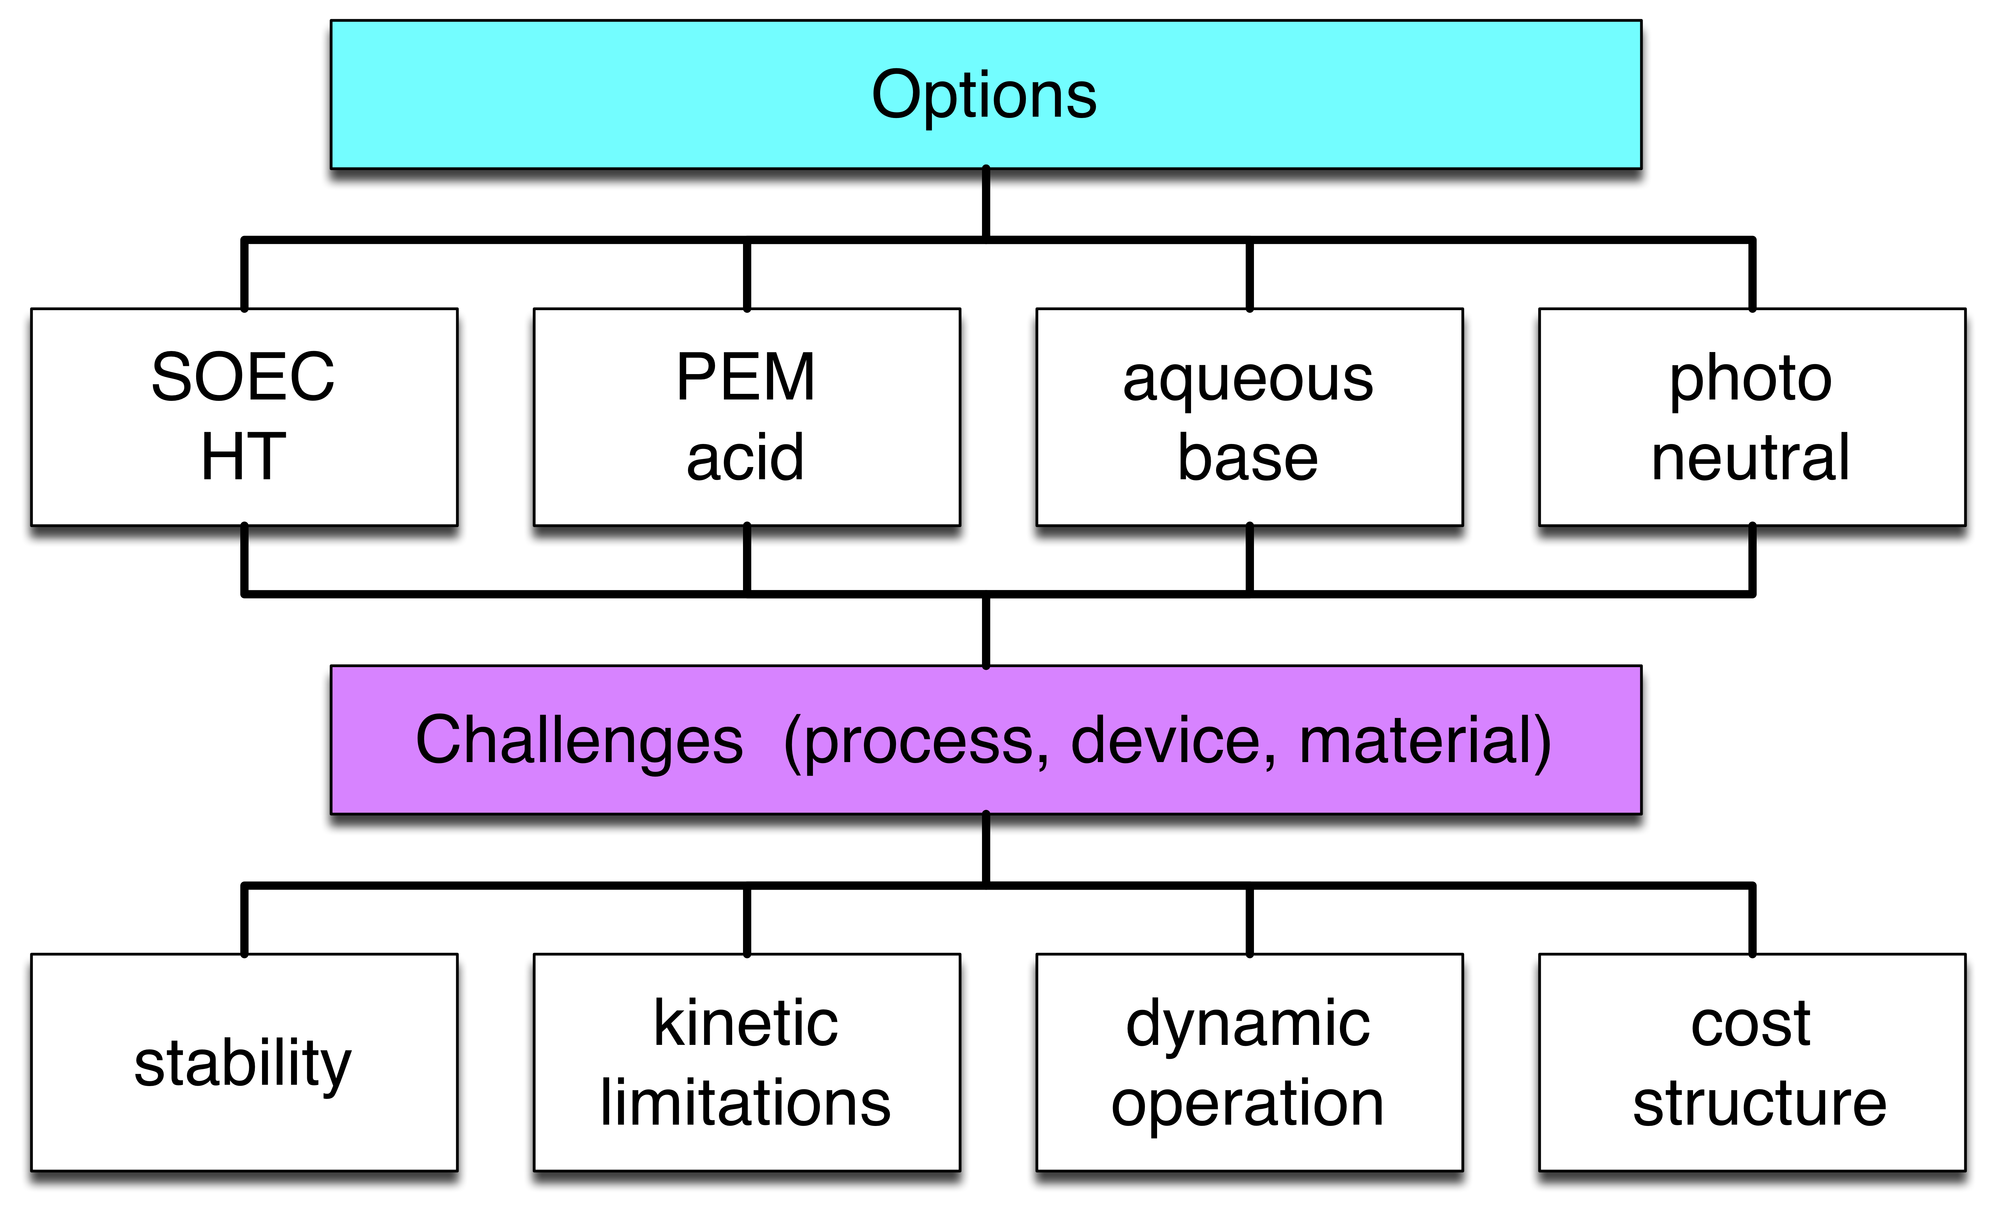
Water splitting
Not a done deal.
Accelerated development required
Example for impeded development through boundary conditions.

Slide 18
Examples for „next steps“
Refurbish existing power plant sites for “green energy”
Hydrogen generation
Backup power (by gasification, hydrogen use).
Learn how to use biomass without long-term damage to the eco-sphere (close material cycles, optimize harvesting for biodiversity, decentralize biomass passivation for sub-zero applications.
Rethink effectiveness arguments (reference point is sustainable energy system from nature, not fossil technology!).
Interact with society to educate systemic complexity and allow for participation in selection of options.

Slide 19
Consequences III
Science and technology development need stable foundations in fundamentals (scale of solutions!).
Reduce over-selling of trial-and-error discoveries.
Be aware of path-dependencies.
Find practical pathways in demonstrator solutions.
Science needs to inform stakeholders more about the broader spectrum of options (example mobility debate).
In science support accelerate creative integrated pathways with all stakeholders united in projects for novel technologies.
Energiewende needs both electrons and molecules:
distinction (and “Sektoren”) are inadequate

Slide 20

Thank You
Dem Anwenden muss das Erkennen vorausgehen
Max Planck
Mache die Dinge so einfach wie möglich aber nicht einfacher
Albert Einstein

